Slide 1


Meltdown & Spectre
Reported by Hanseltu
2018.3.8

Slide 2
ONTENTS
C
1
Introduction video
2
Principle analysis
3
Q&A
3
Demos
Meltdown & Spectre
Mar 8, 2018

Slide 3

Introduction video
Meltdown & Spectre
Part 1
Mar 8, 2018

Slide 4
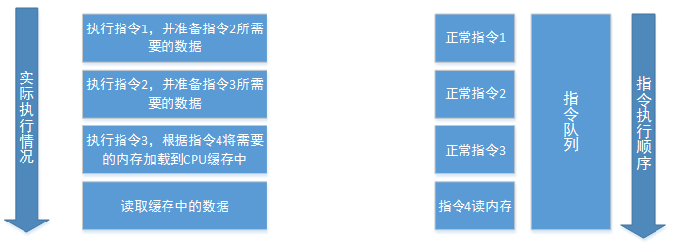
Principle analysis
参考博客：http://gv7.me/articles/2018/learning-notes-of-meltdown-and-spectre/
Meltdown & Spectre
Part 2
Mar 8, 2018

Slide 5
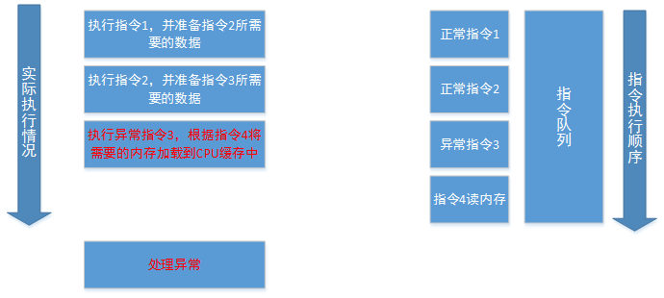
Principle analysis
Meltdown & Spectre
Part 2
Mar 8, 2018

Slide 6
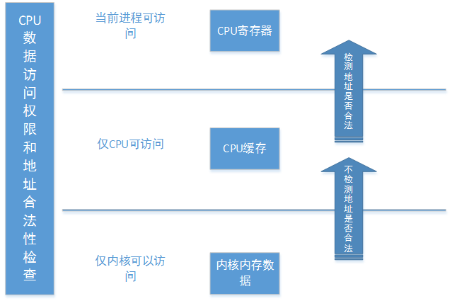
Principle analysis
Meltdown & Spectre
Part 2
Mar 8, 2018

Slide 7
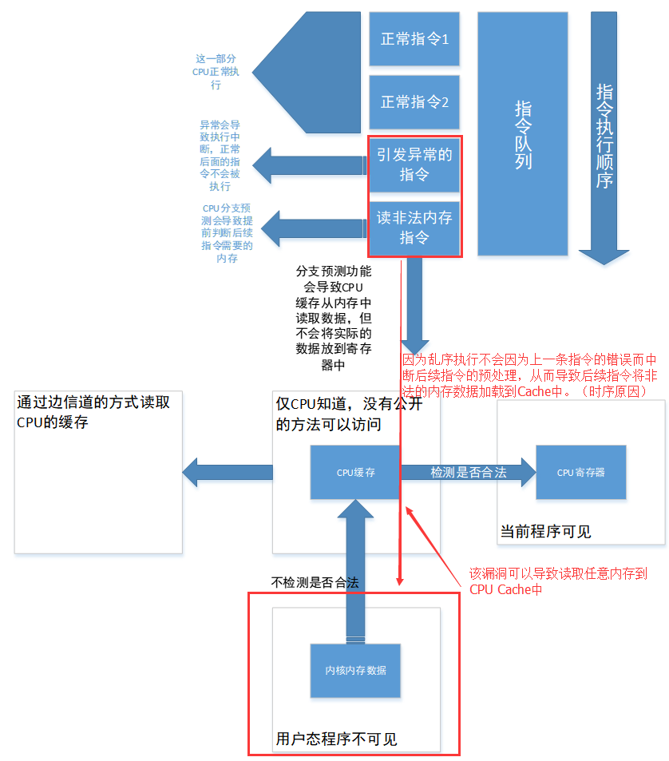
Meltdown & Spectre
Part 2
Mar 8, 2018

Slide 8
Q1:Who reported Meltdown&Spectre?
Melrtdown
Jann Horn (Google Project Zero),
Werner Haas, Thomas Prescher (Cyberus Technology),
Daniel Gruss, Moritz Lipp, Stefan Mangard, Michael Schwarz (Graz University of Technology)
Spectre
Jann Horn (Google Project Zero) andPaul Kocher in collaboration with, in alphabetical order, Daniel Genkin (University of Pennsylvania and University of Maryland), Mike Hamburg (Rambus), Moritz Lipp (Graz University of Technology), and Yuval Yarom (University of Adelaide and Data61)
海量数据
Meltdown & Spectre
Part 3
Mar 8, 2018

Slide 9
Q2:Can I detect if someone has exploited Meltdown or Spectre
against me?
Probably not. The exploitation does not leave any traces in traditional log files.
海量数据
Meltdown & Spectre
Part 3
Mar 8, 2018

Slide 10
Q3:What can be leaked?
If your system is affected, our proof-of-concept exploit can read the memory content of your computer. This may include passwords and sensitive data stored on the system.
海量数据
Meltdown & Spectre
Part 3
Mar 8, 2018

Slide 11
Q4:Which systems are affected by Meltdown and Spectre?
Meltdown Desktop, Laptop, and Cloud computers may be affected by Meltdown. More technically, every Intel processor which implements out-of-order execution is potentially affected, which is effectively every processor since 1995 (except Intel Itanium and Intel Atom before 2013). We successfully tested Meltdown on Intel processor generations released as early as 2011. Currently, we have only verified Meltdown on Intel processors.
Spectre Almost every system is affected by Spectre: Desktops, Laptops, Cloud Servers, as well as Smartphones. More specifically, all modern processors capable of keeping many instructions in flight are potentially vulnerable. In particular, we have verified Spectre on Intel, AMD, and ARM processors.
海量数据
Meltdown & Spectre
Part 3
Mar 8, 2018

Slide 12
Q5:Is there a workaround/fix?
There are patches against Meltdown for Linux ( KPTI (formerly KAISER)), Windows, and OS X. There is also work to harden software against future exploitation of Spectre, respectively to patch software after exploitation through Spectre ( LLVM patch).
海量数据
Meltdown & Spectre
Part 3
Mar 8, 2018

Slide 13
Q6: What is the difference between Meltdown and Spectre?
Meltdown breaks the mechanism that keeps applications from accessing arbitrary system memory. Consequently, applications can access system memory.
Spectre tricks other applications into accessing arbitrary locations in their memory. Both attacks use side channels to obtain the information from the accessed memory location.
海量数据
Meltdown & Spectre
Part 3
Mar 8, 2018

Slide 14
A Demo
Demo #1: A first test (test)
taskset 0x1 ./test
海量数据
Meltdown & Spectre
Part 4
Mar 8, 2018

Slide 15
A Demo
Demo #2: Breaking KASLR (kaslr)
sudo taskset 0x1 ./kaslr
海量数据
Meltdown & Spectre
Part 4
Mar 8, 2018

Slide 16
A Demo
Demo #3: Reliability test (reliability)
sudo taskset 0x1 ./reliability 0xffff880000000000
海量数据
Meltdown & Spectre
Part 4
Mar 8, 2018

Slide 17
A Demo
Demo #4: Read physical memory (physical_reader)
sudo ./secret
taskset 0x1 ./physical_reader 0x390fff400 0xffff880000000000
海量数据
Meltdown & Spectre
Part 4
Mar 8, 2018

Slide 18
A Demo
Demo #5: Dump the memory (memdump)
./memory_filler 9
taskset 0x1 ./memdump 0x240000000 -1 0xffff880000000000
海量数据
Meltdown & Spectre
Part 4
Mar 8, 2018

Slide 19
参考链接
https://meltdownattack.com/#faq-fix
https://github.com/Hanseltu/meltdown
海量数据
本ppt所有资料共享在GitHub上,地址：
https://github.com/Hanseltu/meltdown-spectre.git
Meltdown & Spectre
Part 4
Mar 8, 2018

Slide 20
THANK YOU FOR WATICHING
Mar 8, 2018

